Slide 1
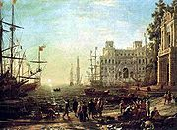
A History of American Business
THE MERCHANT CAPITALISTS
M. HINESLY, M.B.A., D.B.A

Slide 2
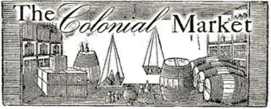
The Rise of Trade & Commerce in Europe
Role of merchants / Mercantilism
State encouragement, direction of economic activity through patents, charters, monetary subventions, and military support
Enhancing the wealth of the merchant in order to enrich the realm. Raw materials from colonies, places to sell finished goods
Role of the colonies and colonial businessperson
Mercantilism vs. individual acquisition & laissez faire

Slide 3
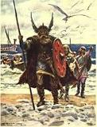
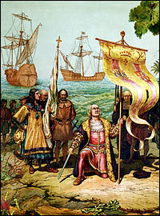
Chris…longer life then most 55 years
Christopher Columbus, Italian Cristoforo Colombo, Spanish Cristóbal Colón, (born between August 26 and October 31?, 1451, Genoa [Italy]—died May 20, 1506, Valladolid, Spain), master navigator / admiral whose four transatlantic voyages (1492–93, 1493–96, 1498–1500, and 1502–04) opened the way for European exploration
10th Century — The Vikings: The Vikings' early expeditions to North America are well documented and accepted as historical fact by most scholars. Around the year 1000 A.D., the Viking explorer Leif Erikson, son of Erik the Red sailed to America.

Slide 4
Christopher Columbus
Columbus: businessman and entrepreneur
History of his voyage – nearly 10 years of promotional efforts
  1474 – plan is originally developed
  1484 – proposal is submitted to King of Portugal; rejected
  1486 – inquiries and alliances in Spain; audience with Queen Isabella; offer of support from count Medina Celi
  1488 – renewed trials of support from Portugal; ignored
  1492 – Columbus’ enterprise is rejected by Court of Madrid and then, later, supported; contractual negotiations are completed

Slide 5
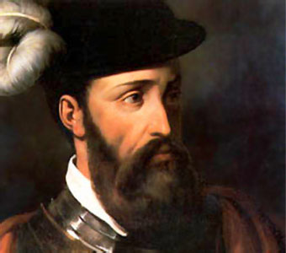
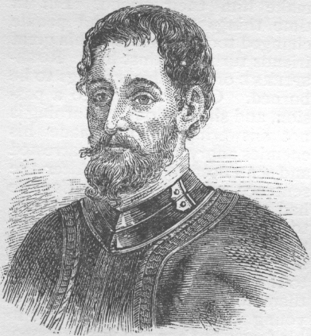
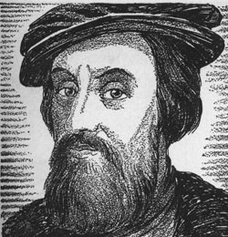
Prototypes of the independent-minded American Businessperson
Spanish conquistadors
  Cortes, Pizarro, De Soto as entrepreneurs and businessmen (conquest & plunder)
  Partnerships
    Predecessor of joint-stock arrangements – compañia/compaña
Francisco Pizarro
Hernando de Soto
Hernando Cortes

Slide 6
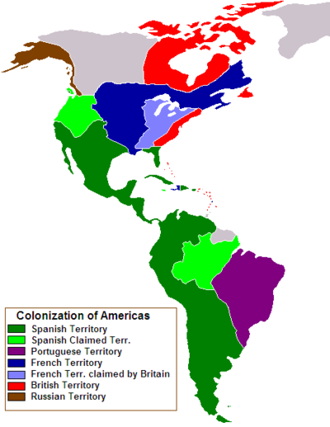
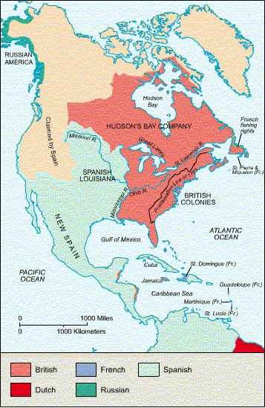

Slide 7
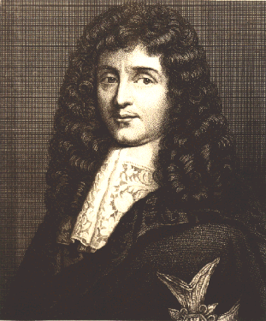
Prototypes of the independent-minded American Businessperson
French merchant-adventurers
  Jean Baptiste Colbert and the West India Company
    Possible Creator of Mercantile Capitalism
    Influence of government on the business structure /function of French enterprise. Sovereign state w/in a state
  Sieur de La Salle & Comte de Frontenac
    Fur trading (highly profitable)
    Established Fort
    1690’s openly defying French policy
  John Law
    Initiated policy of N. America expansion
    The Company of the Indies
    Bubble burst…destitute & condemned
Jean Baptiste Colbert

Slide 8
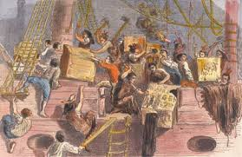
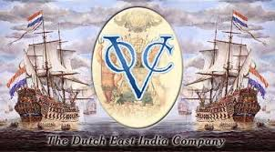
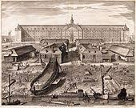
Prototypes of the independent-minded American Businessperson
United East India Company
  Established in the Netherlands 1602
  First joint-stock company of consequence
  Established Dutch Empire in China
  Monopolized Dutch competition in spices
  Created a united front against English/Spanish competition
  Could establish forts, garrisons, appoint
  governors and civil officials
  It was an Independent Merchant Republic
  6.5 million guilders, 6 chambers, 6 cities
  Autonomous control, 1 single account
  Lords Seventeen (real authority)

Slide 9
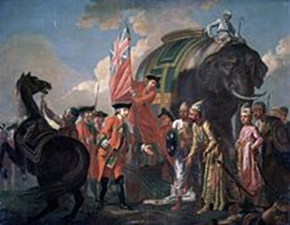
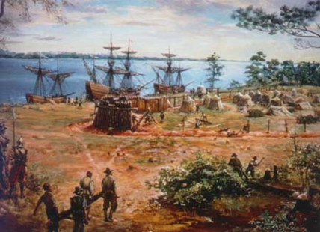

Jamestown (English Proprietors)
1606 King James I
  -Granted letter of patent or charter
  -Treasurer & Company of Adventurers &
  Planters of the City of London
  -143 people 1607 (3 ships)
  Colonist received specific letters of instruction for site selection,
  Building a fort, storing supplies, dealing with natives and
  Exploring for minerals and gold.
  Food to be distributed
  from common storehouse…how to plant…
  Bad to Worse

Slide 10
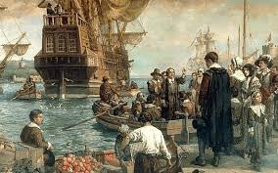
Massachusetts Bay Settlement
Unique in Two Ways:
It was a religious enterprise to establish a
Puritan Commonwealth
The company transferred its charter & governing offices to the new world
Joint stock enterprise w/profits prorated = to value of participation
Freemen, elect board of directors/governors… quarterly meetings
John Smith “meddlesome orders & instructions from English who knew nothing about America”
Success of decentralization & diversification/autonomy

Slide 11
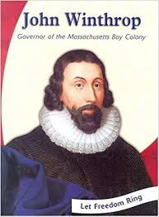
John Winthrop
Self-made businessman
Supervised economic, political & religious affairs of his estate
Served as Justice of the Peace, Steward…
Earnest in his Calvinism
Believed in “work ethic”

Slide 12
South Carolina Proprietors
1663
A measure of home rule
Slavery early adjunct (France…comments)
Rice
Indigo
Profit, or plunder, ruled
Colonies…eventually gains proved worth the risks

Slide 13
Connections between Then and Now
Problems of over-centralization and the need for decentralization
Individualistic efforts
  Role of the entrepreneur
Motives & mechanics of operation
  Profit as the motive behind colonization
Plague of undercapitalization, misinformation, and poor leadership

Slide 14

Questions

